Slide 1
Neo4j
Course Intro

Slide 2
About The Instructor
Brad Traversy
12+ years in web development
4+ years teaching technology courses
Specialize in JavaScript, Server-Side Web Development & DB Administration
Other Courses Available at Eduonix.com

Slide 3
What Will You Learn?
In this course we will be focusing on graph databases and in particular, the Neo4j graph database
What are graph databases?
Why use graphs?
Cypher Query Language
Language Drivers

Slide 4
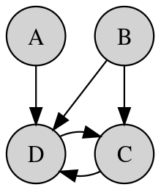
The Graph Data Model
Relational Data Models .vs Graphs
Nodes
Relationships
Properties
Labels

Slide 5
Course Details
5 sections
4-7 lectures in each section
1 Video in each lecture along with a quiz and any project files

Slide 6
Course Sections
Section One – Intro to Graph Databases
Section Two – Getting Started With Neo4j
Section Three – Cypher & Neo4j Browser
Section Four – More On Cypher & Neo4j
Section Five – SocialClient Application

Slide 7


